Slide 1
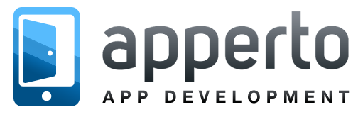
Indie iOS Dev: Things I’ve learned after 7M downloads
Sarp Erdag
Notes:
Hello Everyone,
First of all, a big thanks to the organization team for giving me the opportunity to speak at this wonderful event, I’m so excited to be among so many great developers here today. Really great community and a lovely city. So, thank you.
Today I’m going to be telling you about my story as an indie developer and the things I’ve learned, building apps that got more than 7 million downloads worldwide, generating 1M us dollars in yearly revenue. Now, this isn’t gonna be a technical talk at all, so hope you’ll enjoy this break from all the coding sessions today…
My name is Sarp, and I’m an iOS developer and a designer myself and I’m also the co-founder of an app development studio I named Apperto, based in Istanbul / Turkey.

Slide 2
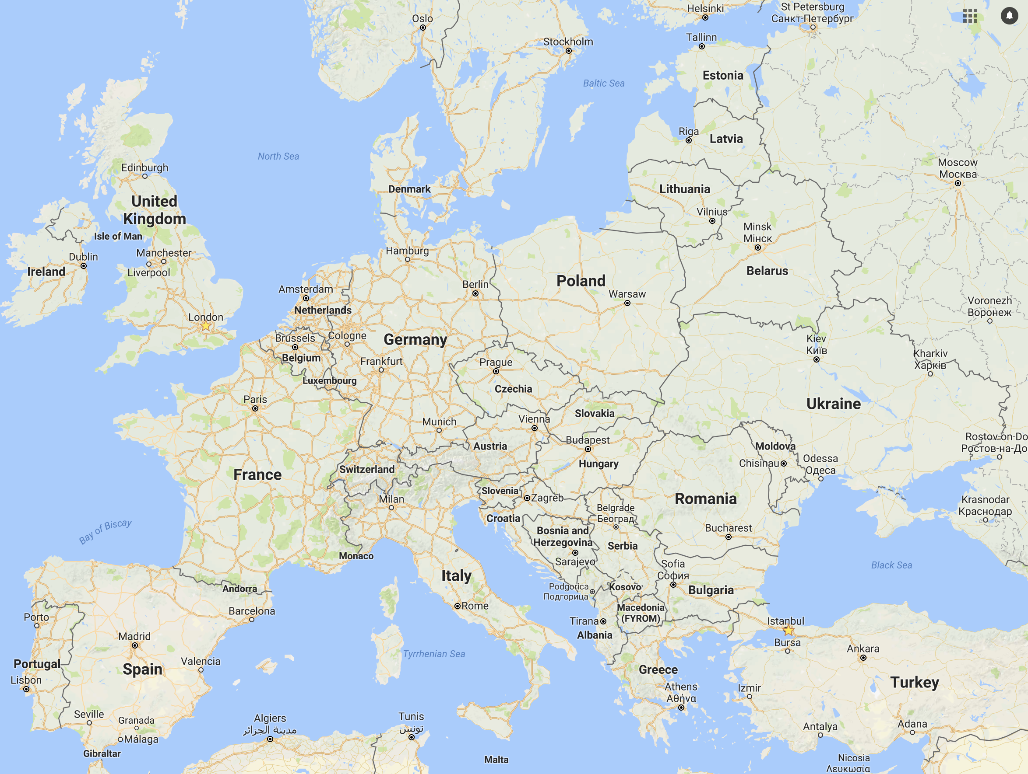
Notes:
So, yeah, although I make regular visits to the US to keep up with the tech community, I don’t currently live here… I’ve actually been here for only 3 weeks now, attended WWDC in San Jose a couple weeks ago and before going back to Istanbul, I wanted to visit Boston and give you guys a talk here at SwiftFest!
For those who are not really sure where Istanbul is, it’s right in the middle of Europe and Asia, where the two continents meet. And you can actually cross between the two continents, through this bridge,

Slide 3

Notes:
which is like the symbol of the city and because it’s a huge city, with more than a 17 million population, there are many people who live on one part of the city, but they work on the other side so each they they cross this bridge to get to their work. And all this, and also the high population and the problems with the infrastructure and everything creates a huge traffic problem. In fact, it’s one of the worst cities in the world to get stuck in traffic.
Anyways, the reason why I’m telling you this is that, I used to work for a software company in my city before I built my own business, and I was spending nearly 5 hours everyday commuting.. My yearly salary was around, 20.000 USD (before taxes and everything). And, 10 years ago, when I first graduated from college, there wasn’t any Google, Apple or Facebook to create exciting jobs and pay good salaries for engineers. The tech scene was limited to a handful of local companies as well, so I had very limited options.
But this situation, this scarcity in general had actually been one of greatest factors for me and my co-founder to take the entrepreneurial path and start building our own products… So, it’s actually pretty simple, we didn’t really have any big plans or any ideas to change the world or anything, we just wanted to break free of the life we got into, after we graduated from college.

Slide 4

FREEDOM
Notes:
We didn’t want to have a 9-5 job, and we wanted to be independent and make a living, learning technologies and building software products we’re passionate about…
By the way, I’m saying “we” but don’t think we’re a big team, we started as two person company and we’re still two people, two developers who are also actually co-founders. We don’t have any employees, we don’t have any fixed office, and we work totally remotely and we make up our own schedule every day to work on the things we like doing. Another thing I love about being independent is that we don’t have a boss or investors that we need to satisfy and we always have the ability to turn this, into a more silicon valley like startup or business if we ever wanna get VC money, take risks and play big.
Let me tell you first a little bit about what we’re doing and later on I’ll get back to our story and give you guys a couple tips on how to find success with your own apps on the App Store or if you have any plans to build an app business in the future.

Slide 5
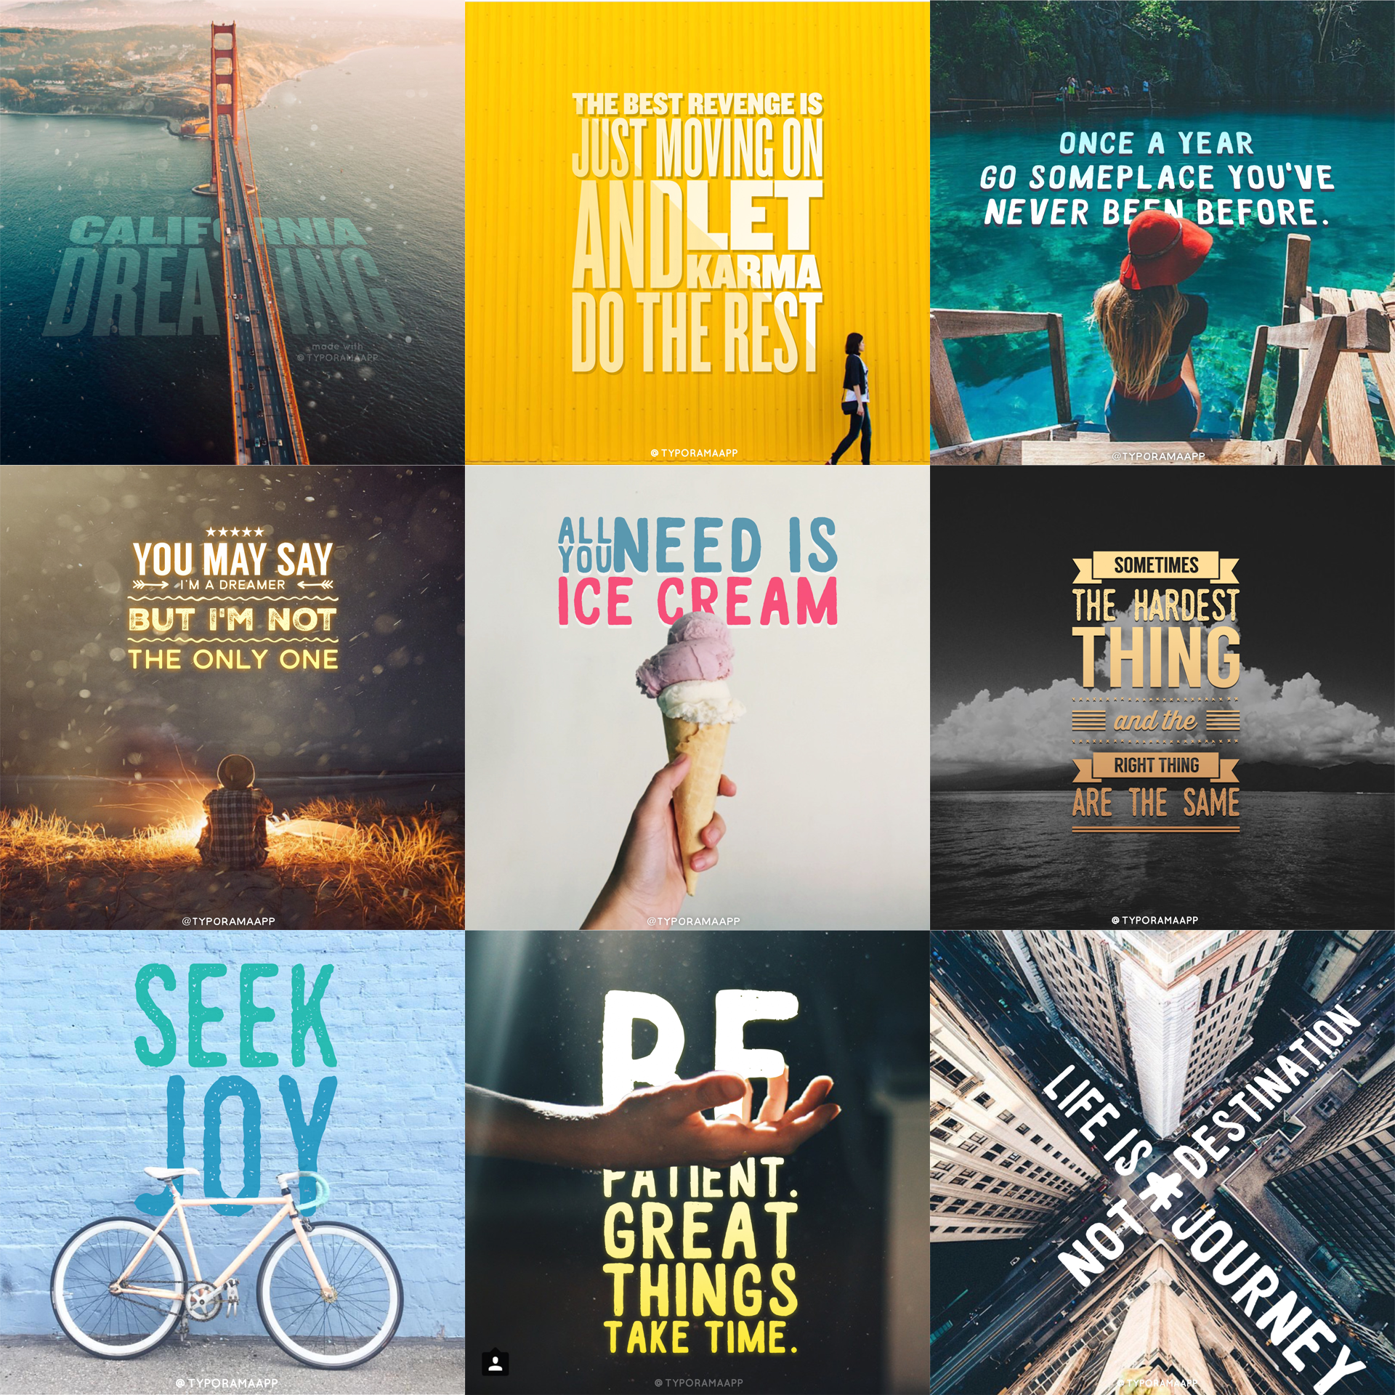
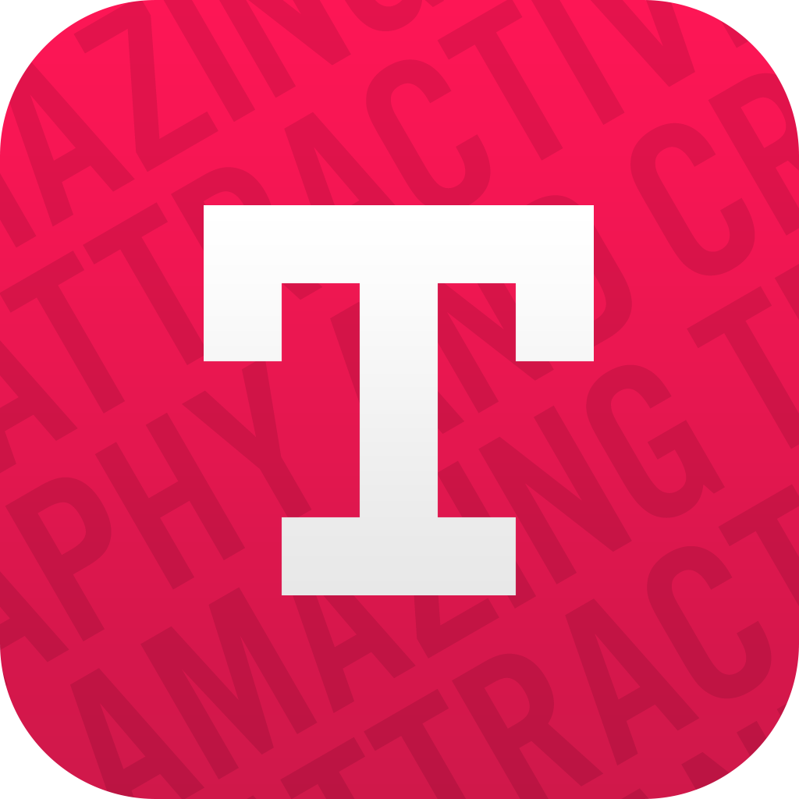
April 2015
TYPORAMA
Easy Graphics & Typography Designer
Notes:
So,
We currently have to apps on the App Store, the first one is called Typorama, which an easy graphics and typography designing app. It was first released on April 2015. The aim is to make everyone feel like a professional designer. So, even if you don’t have any design skills, or don’t know anything about typography or anything, this app lets you quickly create beautiful looking, social media graphics, enables you to use them to promote your brand or business on social networks.

Slide 6
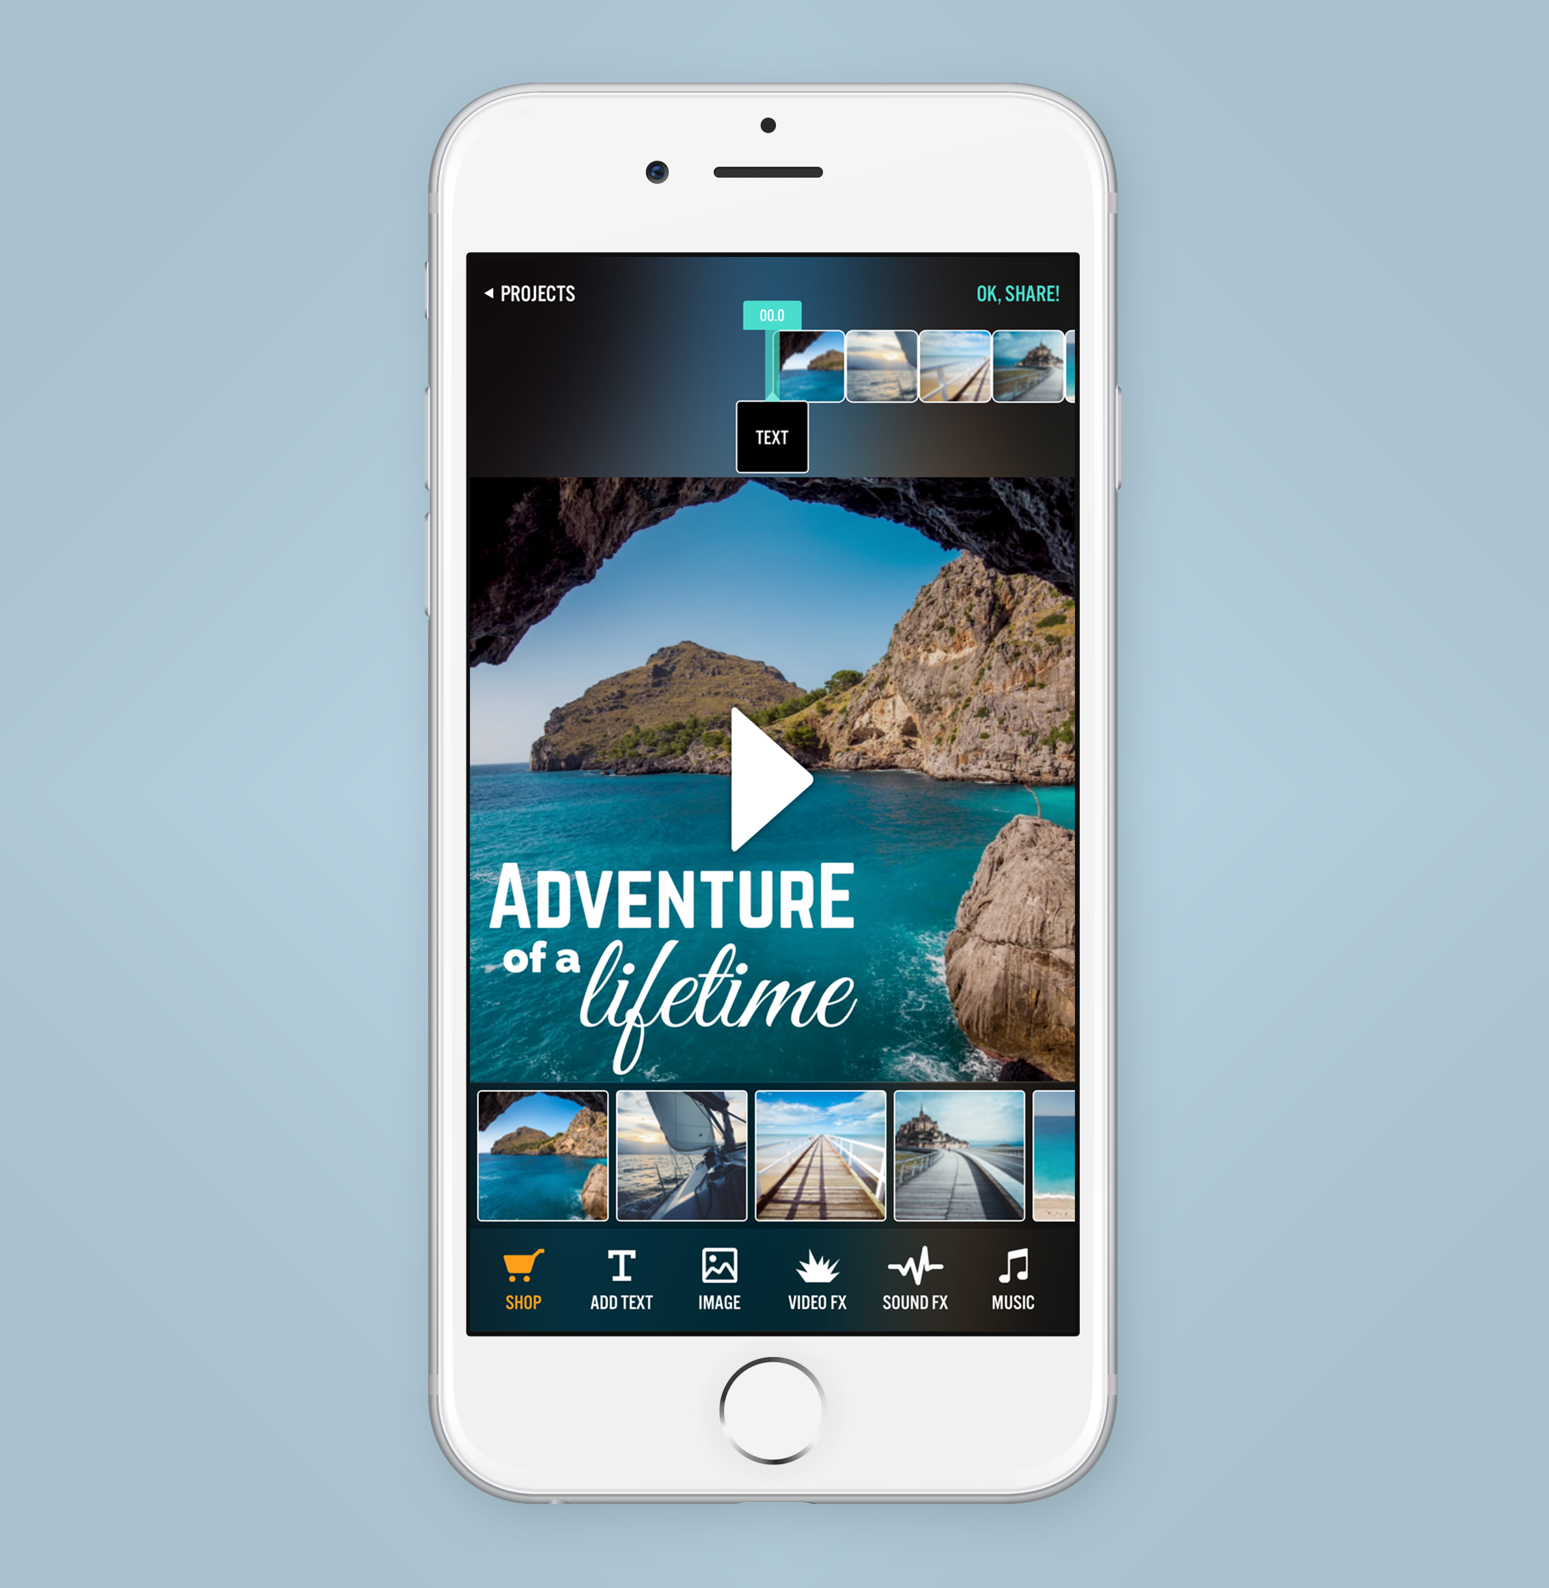
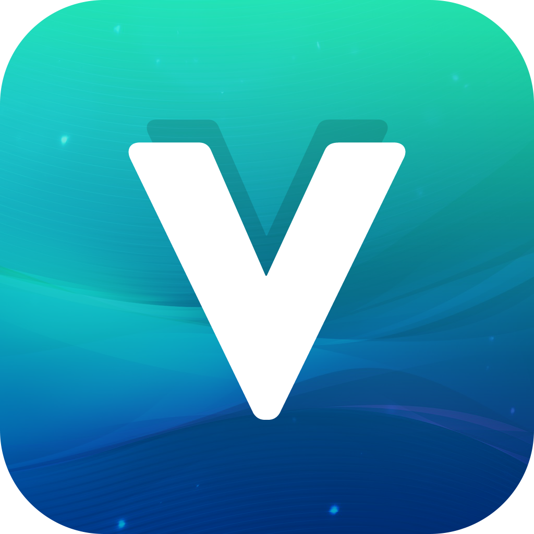
March 2016
VIDEORAMA
Video Editor & Film Studio
Notes:
The second app, Videorama is a video editor more in the traditional sense. So, you combine your photos and videos together to create full length movies. You can then overlay text or images, add music, sounds or even cinematic effects like explosions, rain or snow so on… We really wanted to make it like a mini Hollywood film studio like a combination of iMovie, FinalCut and Adobe After Effects but for iPhones and iPads.

Slide 7
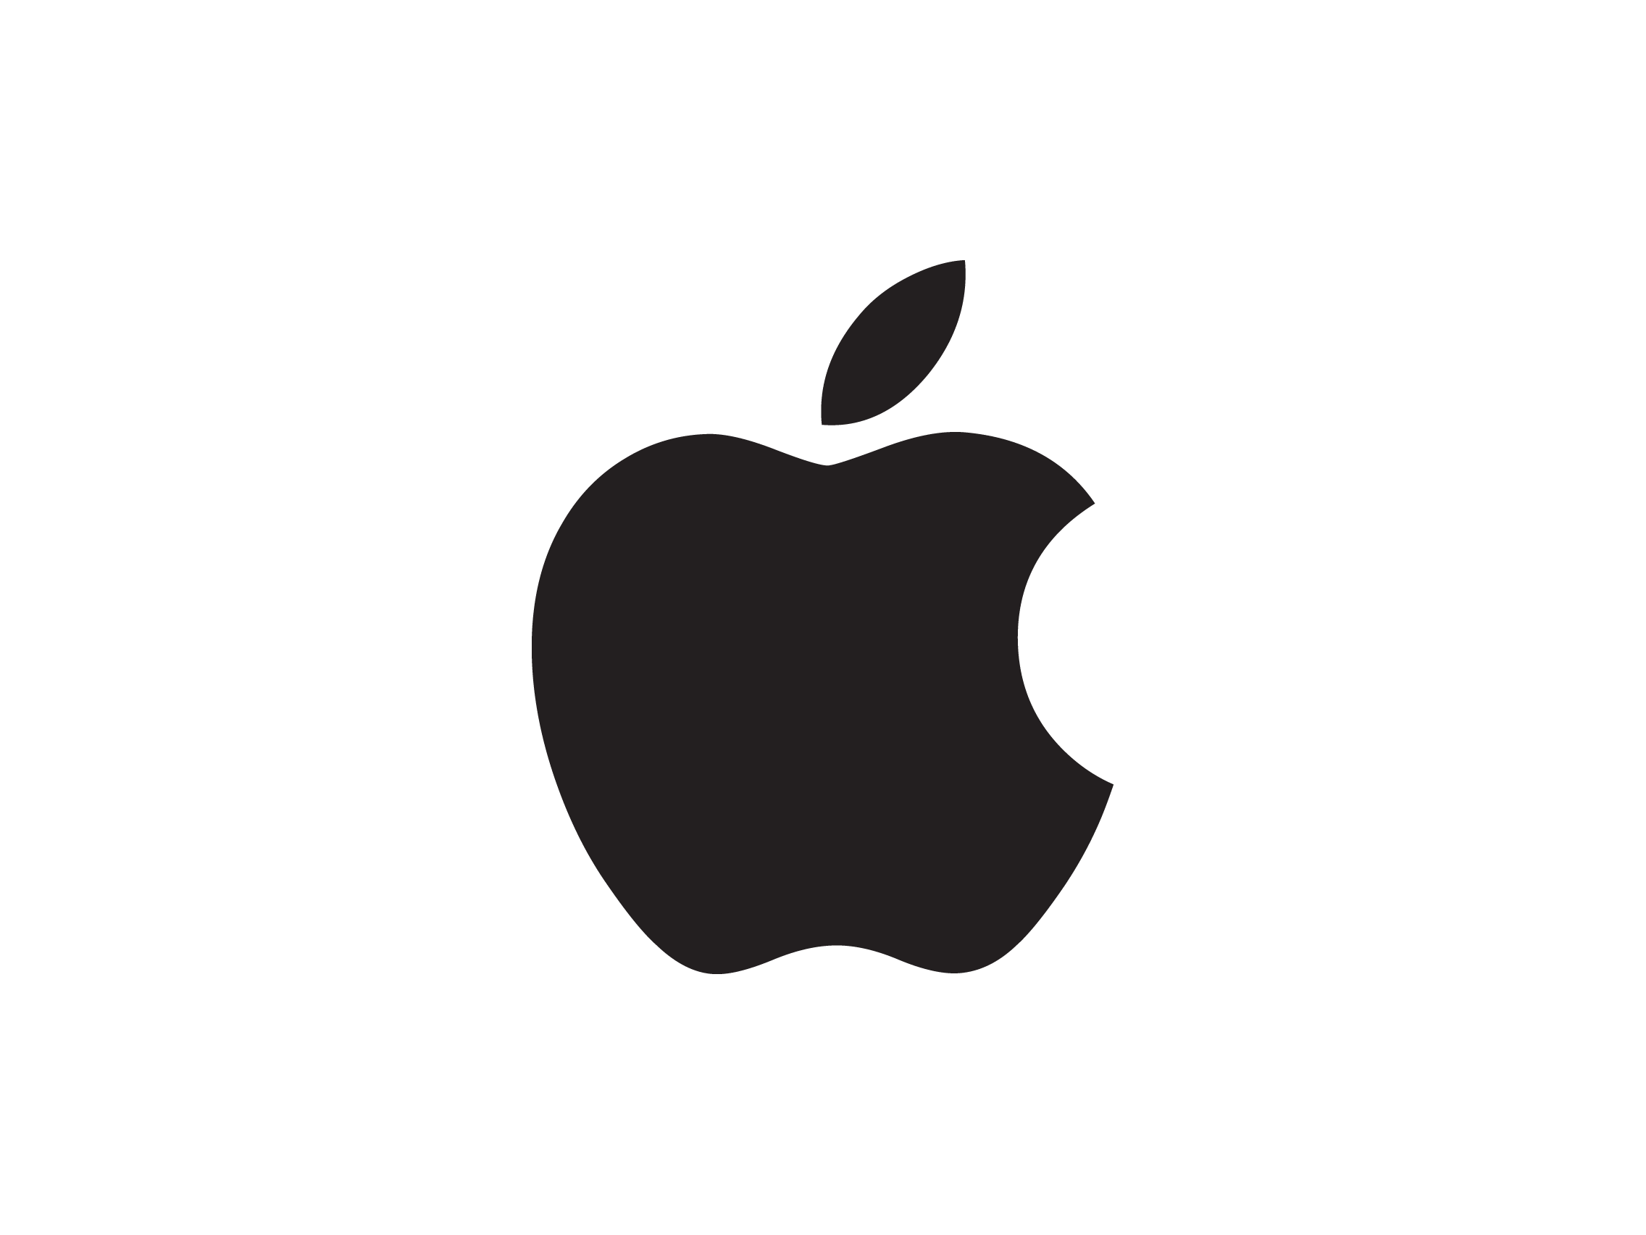
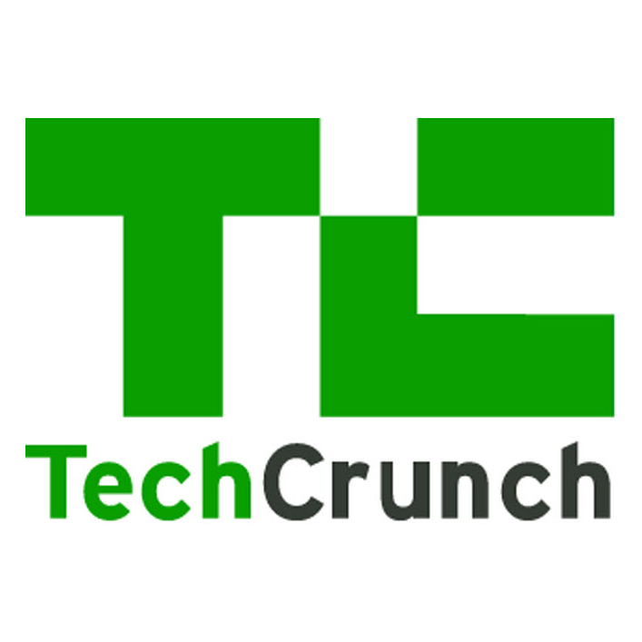
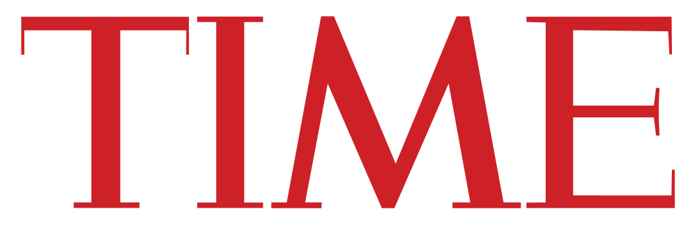

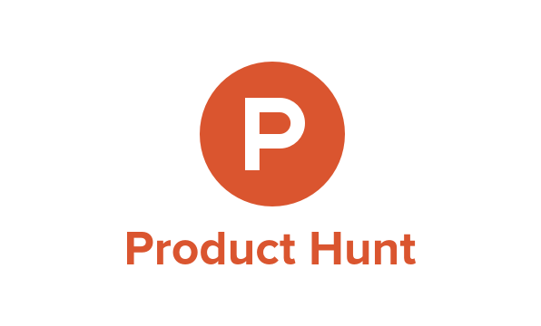
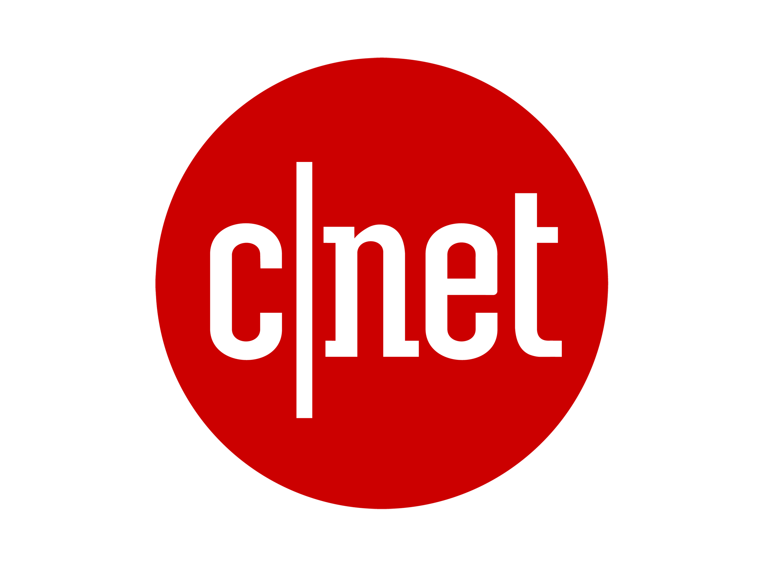


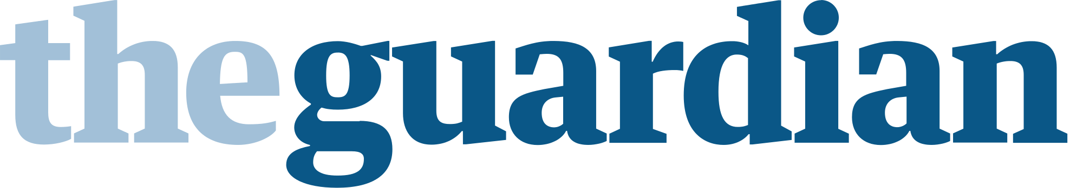
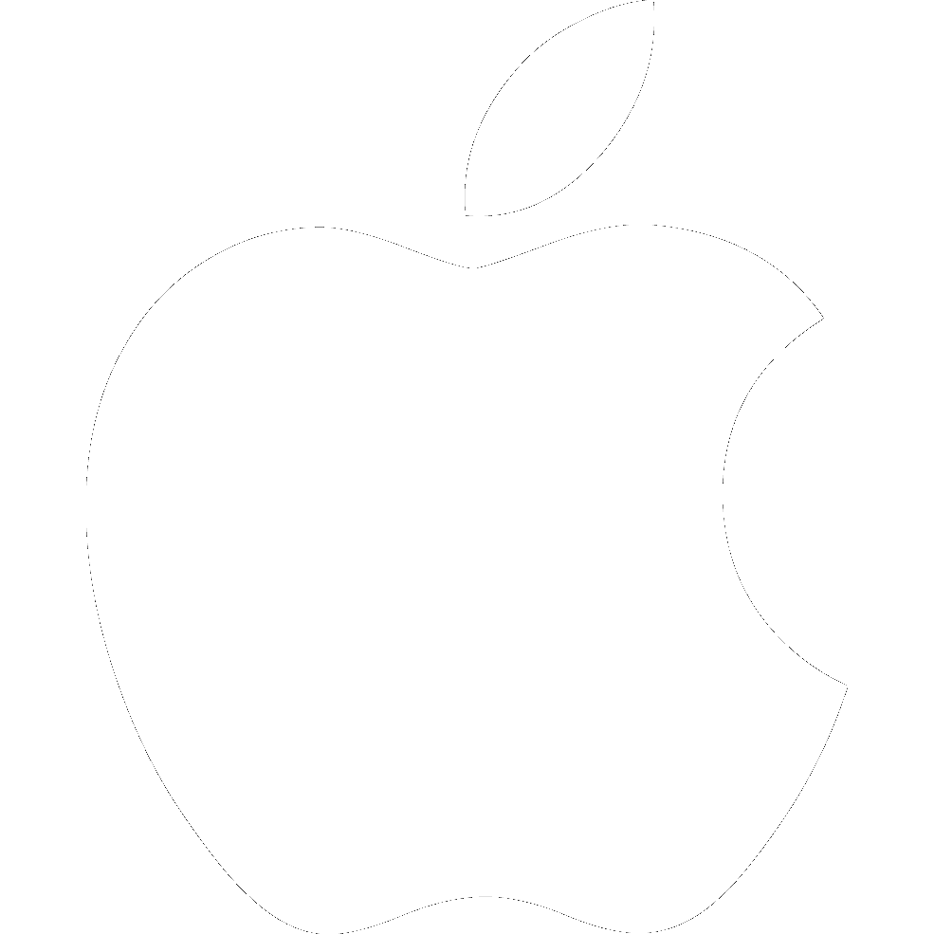
Notes:
These two apps, Typorama and Videorama were featured by Apple various times on the App Store, they’ve been covered on TechCrunch, the TIME Magazine, Entrepreneur Magazine, CNET, ProductHunt, The Guardian Newspaper in the UK, and mentioned in many other printed and online news sources worldwide.

Slide 8
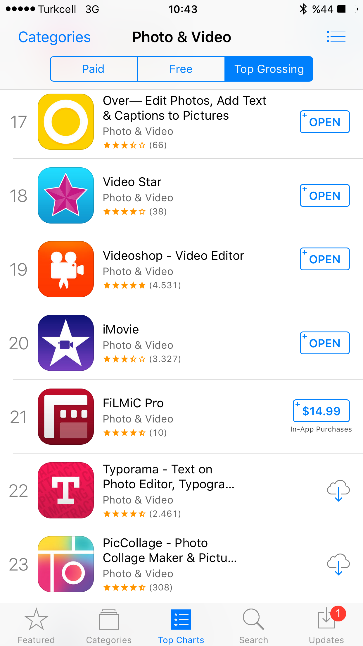
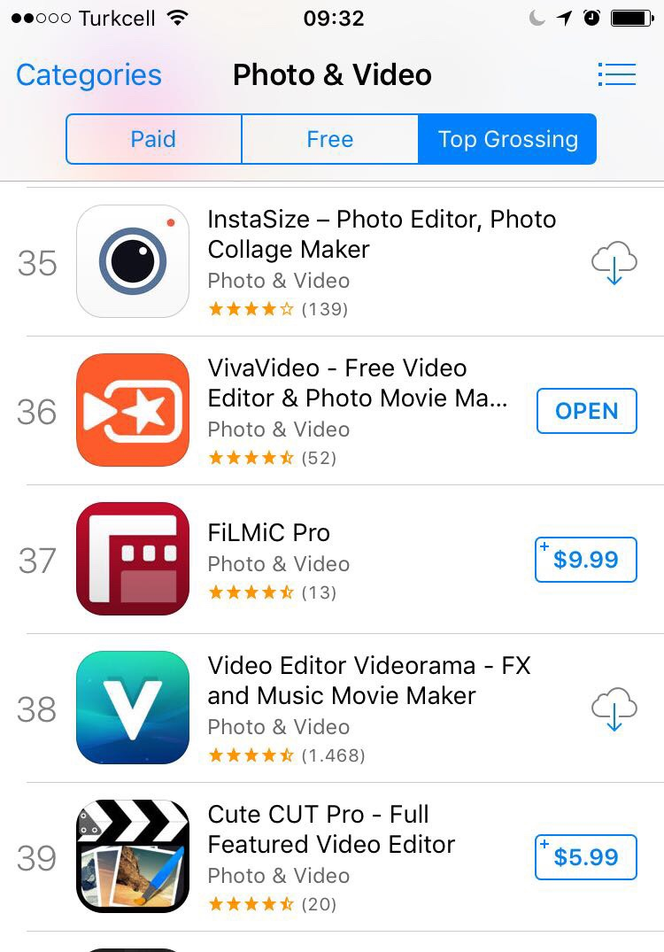
MONTHLY DOWNLOADS
300K
1M
MONTHLY
ACTIVE USERS
Notes:
They currently generate 300.000 new downloads every month, and they have nearly a million monthly active users. And recently, our revenue of the past 12 months has passed 1M US dollars.
Both apps have been in the top grossing photo and video apps list in the US and many other countries, and we’re able to run a hugely profitable business since we don’t have any expenses and we live in a much lower cost country when compared to the US.
Now, how did we do this? Well, it wasn’t an overnight success. In fact, I’ve been trying to build software businesses since I was a kid in high school.

Slide 9

90’s
Gaming Addict
2002-2006
College
2006-2010
Still studying & Working
Notes:
In the 90ties, when I was just 14-15 years old, I was a gaming addict, and as a hobby, I used to write for gaming magazines. Later on I learned HTML and built my own pc gaming related website when I was in high school and learned how FTP is working and how websites function and how you secure your domain name stuff like that. So this was kinda like my first intro into entrepreneurship.
Between 2002 - 2006 - I was in College, studying Computer Science. I learned how to program in those years and I was a little entrepreneurial even then and quickly started building mostly web apps, but I wasn’t able to build anything that can create any significant value… Because I lacked both the business and the technical experience to create my own company. Also, there was no easy way to monetize small projects in those times. There was no App Store, no Stripe no easy way to to get payments from users and the only method I used to earn money was to either make tailored software for other people, small businesses around, or use systems like Google Ads or similar to fund my own small websites…
Between 2006 - 2010 - Later on, I graduated, worked for several different software companies in Turkey, and Iater on moved to Italy for a couple years to get a master degree… Not that I knew how it was really gonna help, but in general, I don’t think I exactly knew what I was doing with my life and was just on the path to become a cog in a big enterprise company…

Slide 10
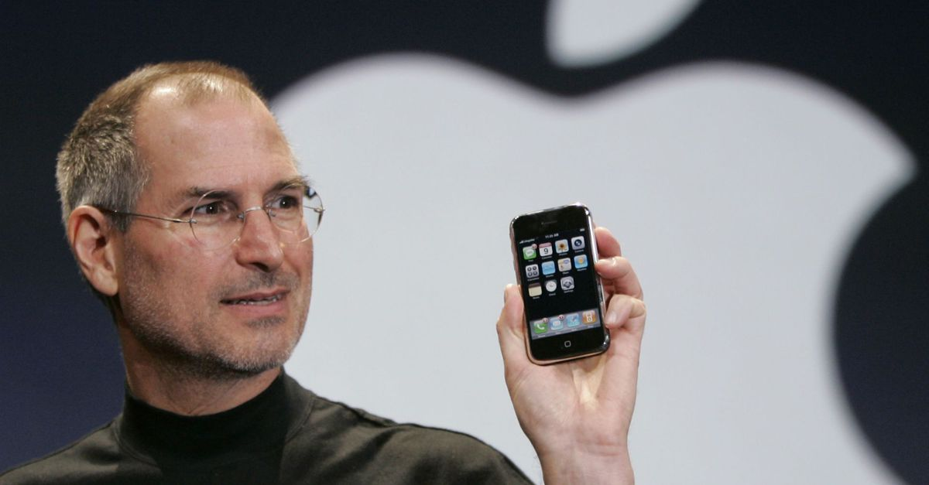
Notes:
But in my 2nd year when I was in Italy, something magical happened…
Steve jobs had announced the first iPhone and a couple yeras later, the iPhone 3G was released. And I was literally mind blown when I saw what Apple had built, the touch screen, the speed of the device and what it can do when combined with the 3G networks was amazing… I believed the future is gonna be there and with the money I earned from freelancing, I bought an iPhone 3G, but of course, development was much harder then, I didn’t even have a Macbook and learning Objective-C that didn’t even have Automatic Reference Counting then was a total pain.
I remember I stopped going to the classes and instead, I was in the university library, teaching myself iOS development, over Stanford University’s online classes. It took nearly a year for me to come to speed with everything and slowly I started building things that can function in a stable manner. Again, as a young developer, who didn’t really wanna get stuck in traffic back in Istanbul, making software for some employer, I decided building a couple of my own apps and earn money through the App Store, but my first 5 app ventures were total, disastrous failures. In desperate need of money, I switched back to freelancing and getting remote work from different parts of the world. I was literally, messaging everyone I found on Twitter who wanted to get an app built and I was helping them turn their ideas into products.

Slide 11

Notes:
And this actually has been really helpful.
It made me learn what kind of ideas people are actually investing in, and why their projects fail or succeed and I was able to learn from their mistakes and plant the seeds of my own app business with the funds I made from project work. This continued until 2015, where my co-founder decided to also leave his 9-5 job and join me to try build a couple of our own ideas on the App Store.
So we released our first app, Typorama.
Our first year was in total survivor mode, we didn’t make much money, but after the first year, things started going much better because we kept taking the correct steps to gain more downloads and we were able to spread our product on the App Store.

Slide 12

Notes:
Now, I'd like to share with you 3 key know-hows I’ve acquired, reaching success with the apps we’ve built.
Now, believe me, we really don’t have any secret marketing trick, or growth hack or anything. And I believe there really is no secret formula to building a successful business.
You’ll find that these keypoints are mostly business lessons, so it might be a bit boring for you tech people, but if you want to build a successful app business, you need to take some time to think about the boring marketing and business aspects of your venture because in fact, these are really what bring success. Coding, you already should be an expert in coding and engineering. But if you combine it with a business approach and market your ideas well, then as developers, we really have super powers in our hands and we have the potential to create massive success stories.
This is what excites me most in my life and I wake up everyday to think of product ideas or features to build and spread it to the use of millions of people worldwide…
So, here we go, here are the things I’ve learned:

Slide 13
FIND THE CORRECT PRODUCT IDEA
#1
PASSION
SKILLS
MARKET
DEMAND
Notes:
1- Start with the correct app idea
So, when you look at the most successful indie apps in the world, you see that they are usually built around the passion and the skills of their makers. If you like playing games with your friends, think of a multiplayer game idea. If you like taking photographs, make a unique photo editor, if you like sports, try building an activity tracker. So try to shape things around your hobbies and professions so that you'll better fill in your own needs and therefore better understand your users.
But of course, just having the passion and skills is not really enough. You’ll also need to find an intersection of your passion, skills and know-how and the demand on the market that can make you good money.

Slide 14
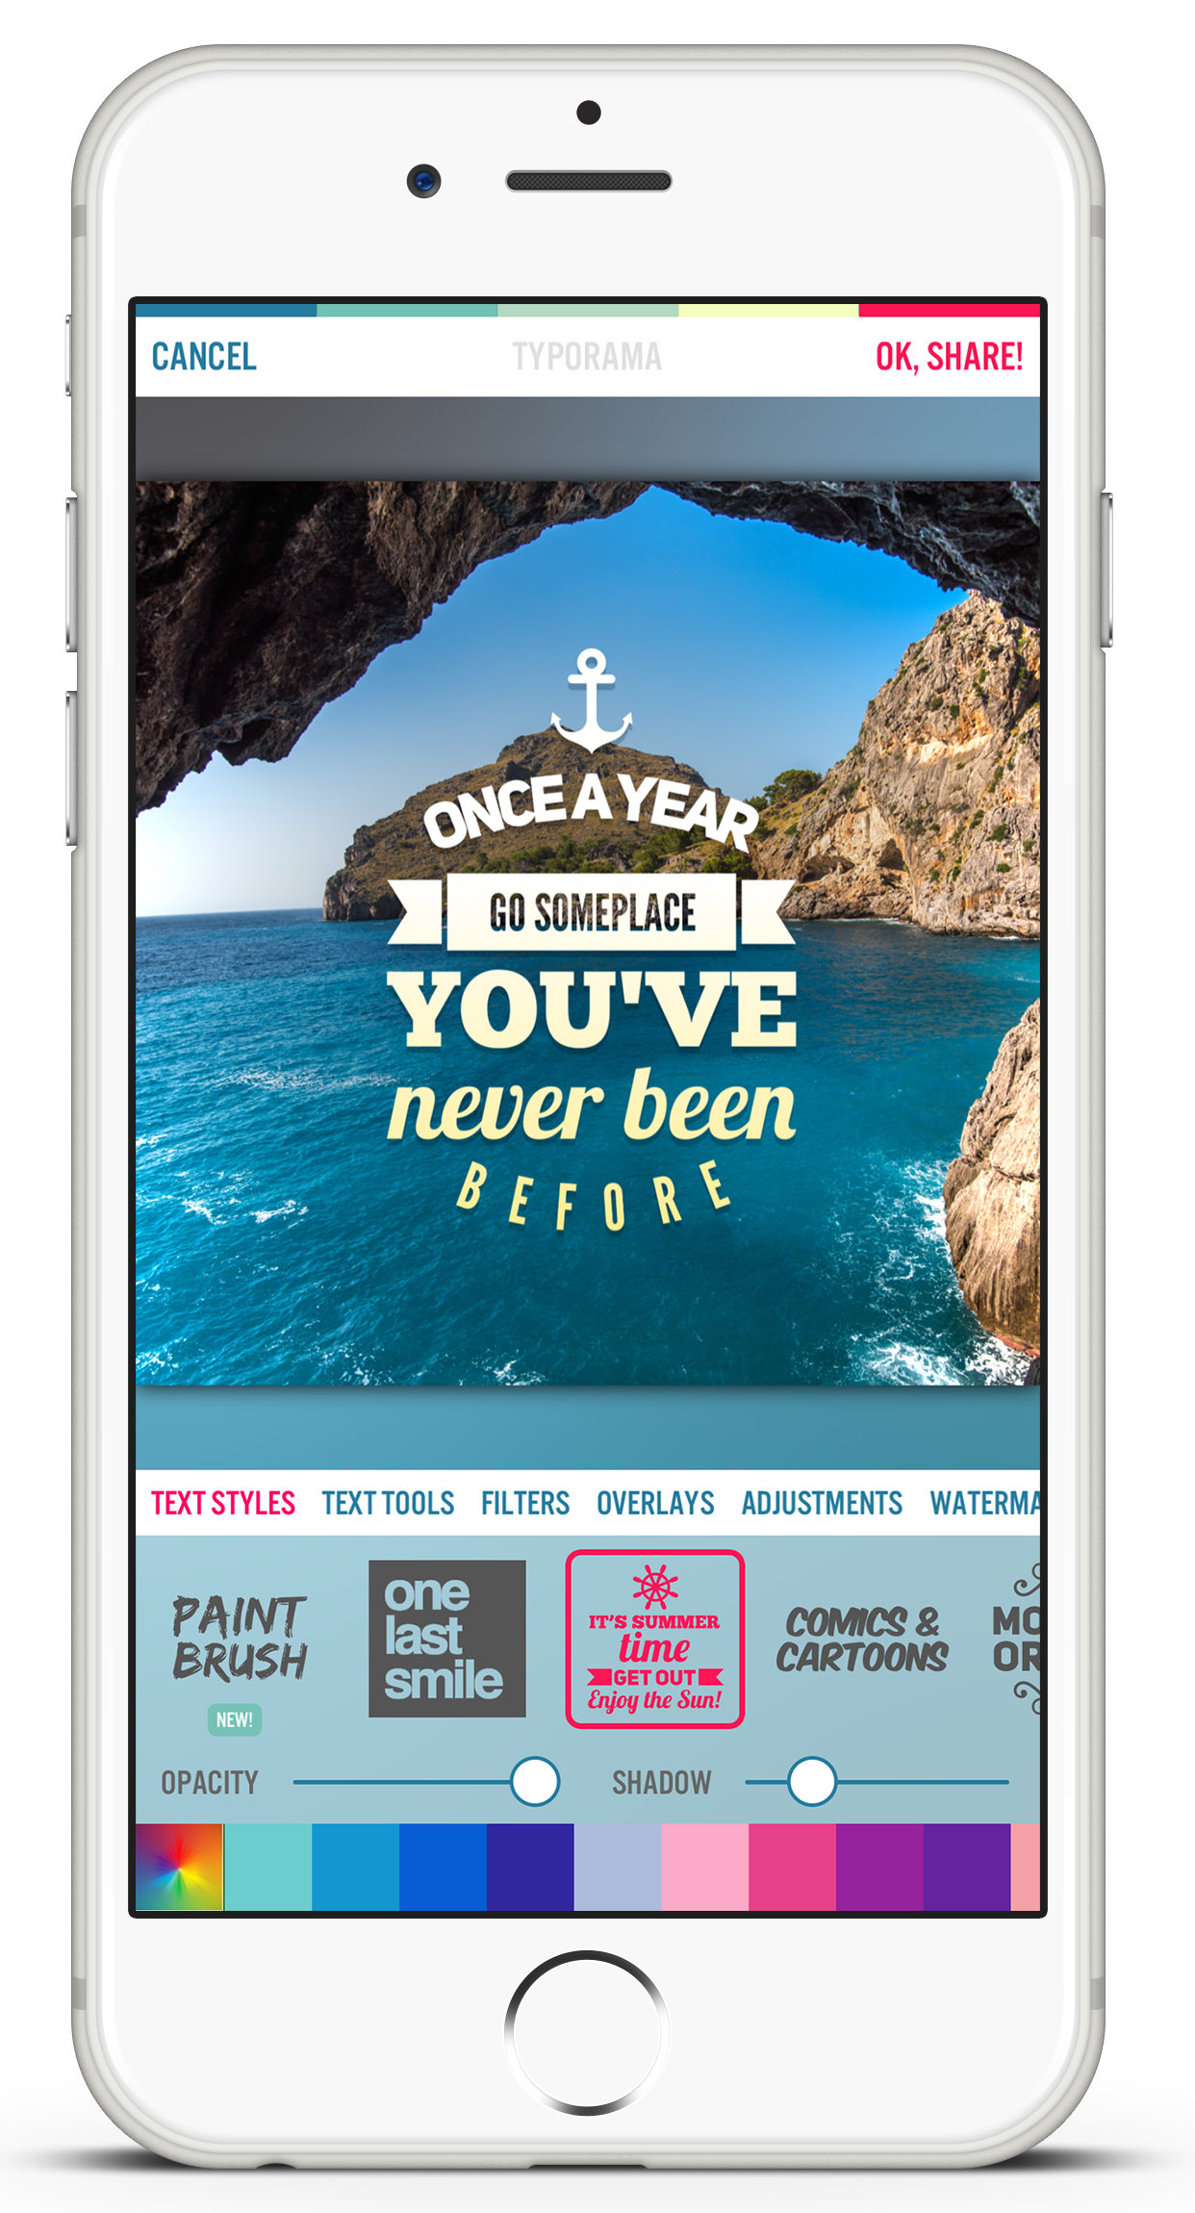
Notes:
4 years ago, while I was. doing client work, I had partnered up with a start-up from the US to build a photo editing app which was like a mobile version of photoshop. It was filled with tons of features. You could do all kinds of photo editing with it. Collages, blending and mixing images, adding stickers over your photos, tons of filters and settings… I loved working on it and kept showing it to my wife at home to get her feedback but she isn’t good with technology and she always said she can’t find the patience to discover everything in the app and learn all the features. She said, “can’t we have something faster to use? - where you just put in a few rules and the design creates itself?"
This immediately turned on a lightbulb over my head and I thought of creating an app that lets you create graphics automatically based on the text you input. I looked up on the App Store to see if there are any similar apps and there was only one. Checked its stats and it was getting downloads and making good money. This meant there was a demand for it. I also had the know-how to build image editing apps because I had worked on similar projects before… So, all the ingredients were there… Still today, I think this model proves Typorama was a good idea to begin with.

Slide 15

March 2017
COLORAMA
Coloring Book for Grown-ups
Notes:
However, of course, we also tried building new apps after the success of the first two, and they weren’t so successful. Last year, we built a coloring book app, named Colorama for instance, but we played to a very crowded market (if you search coloring book on the app store, it gets more than 2000 results and the top 5 are really hard to beat) and we haven’t been able to create much of a difference, therefore it’s struggling to spread organically unlike our previous apps. So now, we either had to spend lots of money on marketing or we needed to create some kind of feature or content that no other competitor has to be able to differentiate ourselves.

Slide 16
FIND THE CORRECT PRODUCT IDEA
#1
PASSION
SKILLS
CORRECT
TIMING
MARKET
DEMAND
Notes:
So, I’d like to add one more aspect to this model here. That is “Correct Timing”. Because if you’re like the 50th clone of an existing popular app, it’s going be extremely hard for you to spread that product.
So, whatever app you build, it’s really important to try to make a difference and try to be the first or at least the second coming to the market.

Slide 17


MAKE A DIFFERENCE
1 MILLION
DOWNLOADS
EVERY MONTH
AFTER LAUNCH
Notes:
I really like giving the app Prisma as an example here.
All of us knows about the photo filters trend that came out with Instagram? After IG introduced filters and let everyone instantly feel like a professional photographer, every other company tried to imitate this functionality adding similar photo filters to their apps and every app tried to clone this feature (just like they are cloning stories now). And nearly all of them were the same, bringing nothing new to the market and therefore being forgotten after some time…
But this Prisma app was able to blow everyone’s minds with it’s unique approach to the photo filter craze. It created such filters that instantly, it converted your photos into works of art, that no other app was able to do before… This way, they were able to spread organically, through word of mouth and social media virality without the need of huge marketing budgets...
So, it's really a vital part of app entrepreneurship to do is to find new ides, that have never been done before…

Slide 18
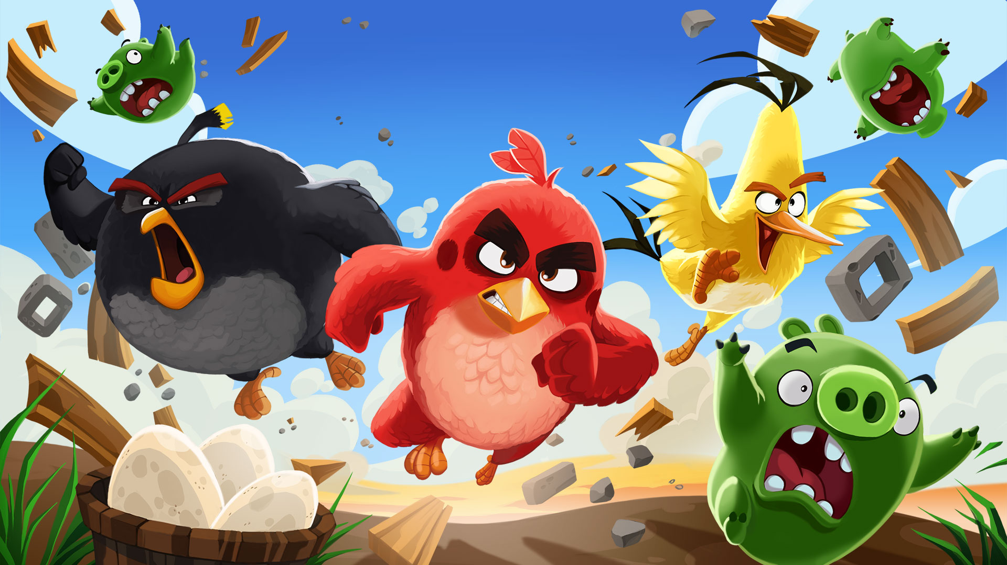
IT WON’T HAPPEN OVERNIGHT!
#2
Notes:
So, I’m sure everybody in this room knows about Angry Birds. It’s a big success it was Rovio’s (the company behind the game) 53rd game. And they almost went bankrupt releasing not so successful games.
So, you might not be able to hit the jackpot with your first try… But you’re gonna have to keep trying…

Slide 19
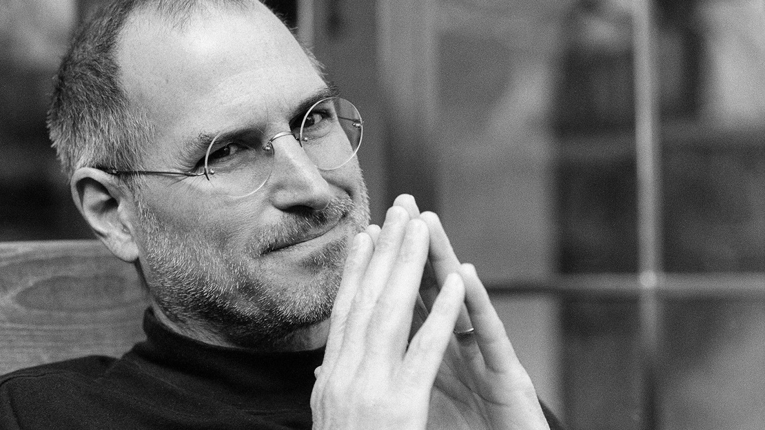
I'm convinced that about half of what separates successful entrepreneurs from the non-successful ones is pure perseverance. – Steve Jobs
Notes:
As Steve Jobs once said “The only thing that differentiates a winner from the loser is perseverance and that he never gives up”… So, keep trying and with each app you’re going to get better and learn many more things that will lead you to success…

Slide 20
MAKE A PLAN!
BUDGET & SAVE UP MONEY
3 – 6 MONTHS
DEVELOPMENT
+ Spreading your app takes time!
Notes:
Another thing I recommend is to make a plan before you start. Make a budget. It doesn’t have to be a boring business plan. Just know how much money you need and how long you can survive with it.
You’re gonna be spending your weeks and months thinking of new ideas and coding and creating mockups and designing and this requires an enormous amount of creativity.
How do you keep yourself creative? By playing with new ideas and getting inspired by what others are doing… This requires time and a clear state of mind where you can experiment new things without stress… So, create room for yourself so that you won’t have to think about how you’re going to survive.
I recommend, saving up at least a year’s money in your bank account because you’ll not be able to make profits before a year even if you release your product… The App Store is filled with apps generating millions of downloads already. There are big companies spending hundreds of thousands of dollars on ads and how are you gonna compete with them? The only way is to find the correct idea and improve your product with each update according to the feedback you’ll get from your users. As the time passes and as you release new updates, your product is gonna spread and it will get its deserved metrics in terms of downloads and revenue.
There’s one thing we noticed with the App Store regarding this is that the older an app is, the higher it ranks in the search results… So, you need downloads. An app might be worse than your app but it might be getting more downloads because it’s more discoverable on the App Store.
Last thing I’d like to note about planning is that you need to keep your development phase at 3 to 6 months. Now, if you have a very innovative idea and if you’re not just investing in better design and usability, it’s gonna take much more time for you to finish the design and coding of your app and you’re gonna get impatient and demotivated as time passes. Focus on shipping as soon as possible so that you can get feedback from your users and learn what you’re doing right or wrong.
For example, especially for games, the biggest reason for failure is not being able to ship… Most of the games never pass the development phase… So, the key is to ship whatever you’re building as soon as possible, with a competitive quality.

Slide 21
FOCUS
#3
DON’T THINK ABOUT VC
BUILD ONE, QUALITY APP
MAKE YOUR $100 on day #1
Notes:
3- Stay Focused & Make money From Day One
Now, especially when you’re the developer yourself, it’s very easy to be willing to try different ideas, features and even churn out new apps as you publish them. When I look up on the App Store, I see tens of different app ideas I’d like to try. I see new apps coming out every day and I think to myself, hey, I can build these and try how it goes as well…
But this is actually a very dangerous urge because if I keep dividing my time into different things, this usually leads to having up multiple, average quality products in my hands.
So instead, I recommend, you to put all your effort in building a single, super high quality app that’s going to beat all the competitors and be the best of the best. Your time is limited and you need to very carefully choose where you’re going to put it into.
Also, think of how you’re going to make money from day one… Remember, this path is not like building a startup full of unknowns and risks. You’re focusing on making a living off your own products. So, think of how your app is going to make money. I personally love ideas that I’m sure are going to earn money and profit from day one. This also helps you to prove yourself, reduce your stress and show you that you’re on the right path. You’ll gain confidence and you’ll get motivated by the money your product’s making. So try to get there from day one.
So, I’d like to think it this way. Even if your app gets a hundred downloads, try to make a hundred bucks out of it. Now, this means an average revenue of 1 dollar per user. Which is great and not that high (because there are many apps on the App Store that have even higher ARPUs). So, if you are able to make a $100, it means you can actually make $100.000 if you take the correct steps. Focus on earning your first $100 bill and celebrate it, It’s a big success!
Lastly, another thing I see that really distracts entrepreneurs is the media itself. Everywhere you see news about apps and startups getting millions of dollars of investment or being acquired by some big company… Well, these aren’t fake news but they aren’t what’s happening most of the time either. The media doesn’t like talking failures, or about small teams struggling to earn a couple hundred thousand. Instead, they keep focusing on huge VC investments and big exits… So, I’m not telling you not to think big, but realize you’re starting small, self funding yourself and be realistic about growing organically.

Slide 22
GET READY TO WEAR MULTIPLE HATS AT ONCE
#4
Notes:
Building a product on your own or with a small team will require you to do almost everything on your own.
So as developers, many of us think we're not doing any actual work if we're not writing code. I don’t know about you but I always had this mentality, maybe some of you have felt the same. But most of the days, especially in the beginning, if I’m not writing code, it always felt like I’m not doing any valuable work.
It seems like writing code and building the app itself is the single only thing that matters to build a quality product and then after you release your app, I always though, users will flock to it and start using it.

Slide 23

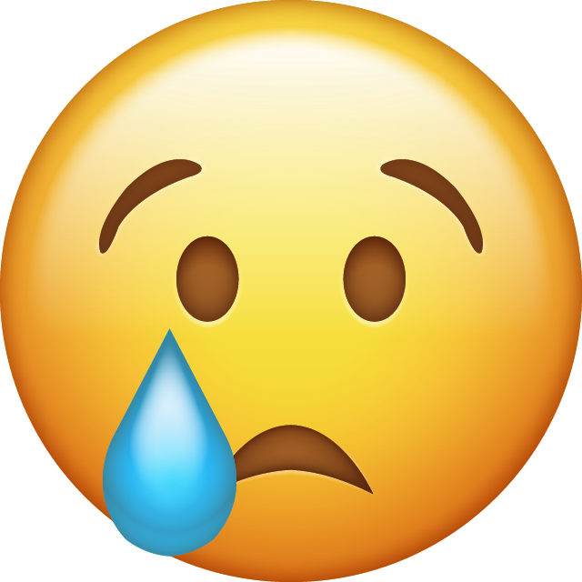
50
DOWNLOADS
ON FIRST DAY
Notes:
Well, here's the ugly truth. You're most likely to get zero downloads after you ship... That’s what happened to us, that’s what happened to our apps. 4 years ago, we released our first app, and it was like a drop in the ocean. Nobody knew about it, we got only 50 downloads in the first day (even if it was free)
So.
Even if you have built the most amazing app on the surface of the earth, you're gonna have to do some kind of marketing to get it known by people. You're going to have to test ad networks, try to find a profitable area where you can spend some money on. You'll have to learn App Store Optimization. Maybe talk with celebrities or influencers or bloggers and all this requires lots of time and skills. And it’s gonna be on you, you’re gonna have to do everything by yourself.

Slide 24
CODING IS
ONLY 1/3
OF THE JOB
FIND A PARTNER
BECOME A GENERALIST
Notes:
So, think it this way,
Coding is only 1/3 of the job...
And it's not only coding and design and marketing and App Store Optimization... You're gonna have to do your own accounting, insurance, know the regulations and laws in your country to pay your taxes properly, know the law to do proper contracts with people and companies you work with. Yes, becoming independent brings freedom, but it also brings lots of responsibilities and you're going to have to deal with all the aspects a business that need to make profits... So get ready to wear multiple hats at once...
One thing you can do to ease your work here is to maybe find a partner, a co-founder for yourself. And while choosing a partner, keep in mind that it's someone you know, trust and have similar lifestyles and goals. It's also better if he or she has complimentary skills to you so that you can outsource each other things you're not specialized at.
For example, my partner Cagatay is better at creating backends and I'm better at frontend. I do the graphic design of our apps, while he does accounting. I do giving customer support while he does operations. So we both wear multiple hats and we try to share the work according to what we're good at.
Lastly, the point here is that if you're gonna work for a company, it's better to be a specialist. But if you're gonna build your own products, get ready to become a generalist.

Slide 25

STAY CALM
Notes:
One last thing,
Try to stay calm, no matter what...
Remember, you’re doing a creative business. You need to keep your sanity and your well being so that you wake up with fresh new ideas every morning.
If your app gets featured by Apple, don’t think you’re good to go now. If your app gets hacked or something, or if you release a shitty update that fills your inbox with complaints from your users, it’s not the end of the world, you’ll fix it. When something really good happens, don’t be spoiled by it. When something bad happens, don’t get stressed. Try to stay calm no matter what…

Slide 26
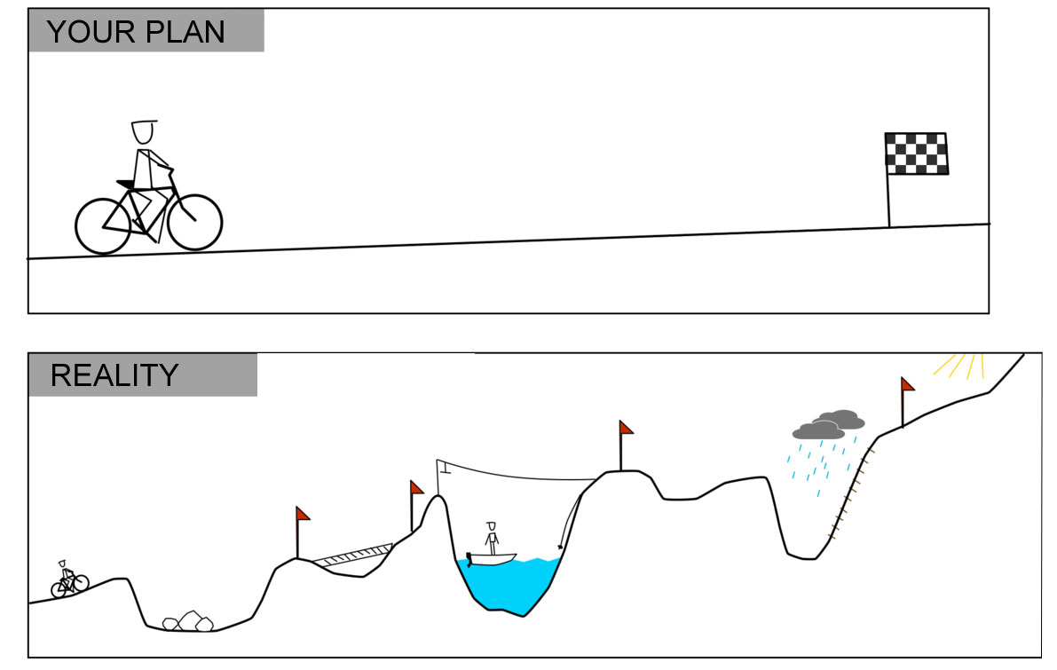
Notes:
Because it’s not a straight path to success and your journey is filled with obstacles, good and bad days.

Slide 27
SARP ERDAG
Mail: sarp@apperto.com
Twitter: @sarperdag
Notes:
Thank you!!! Again, my name is Sarp Erdag and you can always reach me via email or twitter. I love discussing app ideas with entrepreneurs and would love to give feedback and also hear what you think about our apps any time…

Slide 28
PROMO CODES!
www.redeemco.com/g/swiftfest-tra/
www.redeemco.com/g/swiftfest-vdr/

